Slide 1
Web Programming
Hashing and sessions
hashing stored data
using sessions to maintain state

Slide 2

The need to hash important stored data
Hashing
Example: if passwords are stored in plain text, e.g.
Could that be a problem?
Yes, it could potentially be read by hackers

Slide 3
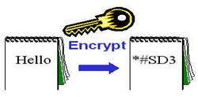
Hashing and the storage of data
Hashing
Use one way hashing algorithms to hash data such as passwords. Example - CRYPT_BLOWFISH
Examples of php hashing functions
  crypt()
  password_hash()
Example of use - compare user input with that in a database to authenticate passwords
Encrypt important stored data
Source: Felke-Morris

Slide 4
Hashing algorithms
Hashing
Algorithms that take blocks of text (of different sizes) and transforms them into a fixed length hash value
  Should always give the same hash for the same text
  A one-way hashing algorithm like CRYPT_BLOWFISH can be used to encrypt passwords (or other sensitive data)
    The hashing algorithm effectively “scrambles” the password text converting it to a meaningless set of characters. Example
    12tf$t2759#Esz
    could become
    $2y$10$jskbOkCE2LBU5kRRa3CH8uJ2ghk/82mggliuPvxyqH1FDigP6Nvnu

Slide 5
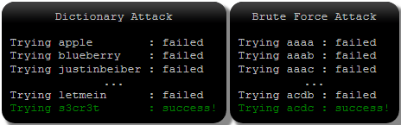

Problem with hashing
Hashing
Problem: if the database is compromised the attacker has the hashed passwords
  Doesn’t directly help as you still need the original password to login. However,
Easiest way to crack a hash is by guessing
  Dictionary and brute-force
  attacks
    Make harder by
    - enforcing long passwords
    - using slower hash algorithms
  Lookup tables
    Alleviate by adding a salt
Source: crackstation.net

Slide 6
Adding a salt
Hashing
Lookup tables work because if only hashed then the same password should always gives the same hash
We can strengthen a password hash by adding a unique, randomly generated long ‘salt’ (a string) to each password and then hashing the combination
  This makes it harder for a lookup table to be pre-computed as each possible password guess would need each possible random salt adding to it
Don’t use
  the same salt for every password
  a short salt
Source: crackstation.net

Slide 7
Password hashing - password_hash()
Hashing
Format: password_hash(string to hash, algorithm [,options])
Algorithms - include
  PASSWORD_DEFAULT, PASSWORD_BCRYPT
Option – cost
Example:
  $option = [
  'cost' => 12,
  ];
  $passwordHash = password_hash($password, PASSWORD_DEFAULT, $option);
The algorithmic
cost
The password that we want to hash
Optional array that can include the cost
The hash produced
The algorithm to use

Slide 8
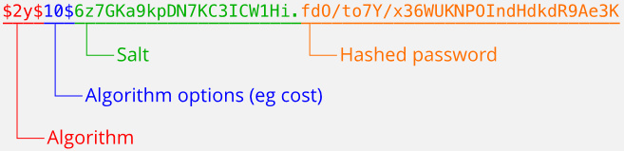
Algorithm, cost and salt with password_hash()
Hashing
password_hash() can automatically generate a salt and use it to produce the hash
The hash value returned by the function includes the algorithm used, the cost and the salt (we need to store all of this in a database)
The hash provides all the information on the algorithm and salt required to verify the password later (during logon)
Example:
Source: www.php.net

Slide 9
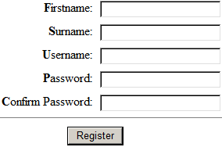
User registration with hashing - using password_hash
Hashing
  During user registration we can generate a
  password hash of the password entered by the
  user using the password_hash function
  We can then store the hash in the database rather
  than the actual password as part of a new user record, e.g.
  Attackers can’t now as easily determine the original password by looking at just the hash in the database
  Note: the original password is NOT stored anywhere
  NEVER STORE THE ACTUAL PASSWORD IN THE DATABASE

Slide 10
Verifying a password – password_verify
Hashing
Verifies that a given password attempt produces a given hash
Format: password_verify(password attempt, hash)
  password - the password entered by a user to check
  hash – a hash created by password_hash
Example:
    if (password_verify($password, $correctPasswordHash)) {
    // Do action for correct password
    }
    else {
    // Do action for wrong password
    }
The password to verify (e.g. one from a logon form)
The hash we want to verify against (e.g. one retrieved from db. storage). Ex:

Slide 11

Logon with hashing – using password_verify
Hashing
Steps to use password_verify in logon:
  User enters username and password in logon form
  A user records database table is queried for a user record containing
  the username entered and the hashed password is retrieved if the
  username exists. If one exists
    password_verify can be used to check if the hash of the password entered by the user in the logon form is the same as the hash stored in the database
    If yes, access is granted. If no, then access is not granted

Slide 12
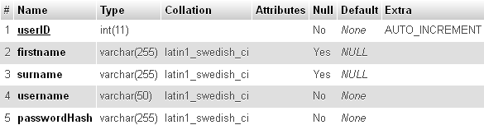

Registration form and database design points
Hashing
Form: don’t overly limit the size of password entry allowed as this can make brute force attacks easier
Database user table for use in registration and logon:
A username and the password hash are required
Make the password field big enough to store the password hash (now and in the future)
Each username needs to be unique

Slide 13
Logged in: remaining logged in
Sessions
We’ve handled logging in but how do we STAY logged in on every page?
We need to maintain user login state info
Problem: the web is a ‘stateless environment’
One solution is to use sessions
Home
Logon
‘Protected content’

Slide 14
Session example
Sessions
Client
Web server
Generate session ID,
set cookie, create
session file with
logged in status
variable, e.g.,
Request for, e.g., login.php
Web Browser
Response:
set cookie “PHPSESSID”, to, e.g. sess_0pm0g9736asl2bc54ku9e29
Send login page
logged-in|s:4:"true"
Request for, e.g., admin.php.
PHPSESSID=sess_0pm0g9736asl2bc54ku9e29
Find and access
session file, read
status variable, e.g.,
Web Browser
Send admin.php page
logged-in|s:4:"true"

Slide 15
Using sessions
Sessions
Way of storing variables on the server and making them available across multiple pages
Scripts that use sessions need to start with:
  ini_set("session.save_path", "/home/USERID/sessionData");
  session_start();
Specify where to store session variables – here a folder with restricted access to improve security
Note: nothing must be sent to the browser before this
Creates a new session with a session ID (by default creating a session cookie on the client and a file on the server with names based on the ID) OR resumes a current one if one already exists (if there is a session file on the client)

Slide 16
session_start()
Sessions
session_start()
Check if there is a current session file set on client
If NO
If YES
Create new session with a session ID, e.g.,
sess_0pm0g9736asl2bc54ku9e29
Resume current session

Slide 17
If no current session
Sessions
session_start creates a new session with a session ID, e.g.,
sess_0pm0g9736asl2bc54ku9e29
Server
Create a file on the server with a name based on the session ID
Client
Create session cookie file on client - set cookie “PHPSESSID”, to, e.g., sess_0pm0g9736asl2bc54ku9e29
Next we can write session variables to the server session file to store data

Slide 18
Writing data to sessions
Sessions
We can store data from one page for another page to access later by writing it to a variable inside the session file on the server. Example
ini_set("session.save_path", "/home/USERID/sessionData");
session_start();
$_SESSION['username'] = 'Garry';
Here we create an element in the server’s $_SESSION array called ‘username’ with the value ‘Garry’.
The elements of the $_SESSION array are written as session variables to the session file. Note: you can have as many variables as you like
username|s:5:"Garry";

Slide 19
If there is a current session
Sessions
session_start resumes a current session, say for a page that wants to read data set by another page
Retrieve session ID from the session cookie file on the client – e.g., PHPSESSID= sess_0pm0g9736asl2bc54ku9e29
Send the session ID to the server and find the session file with the required session ID
Read session variables and populate the $_SESSION array with their contents
Access the $_SESSION array to 1. get the data originally set (e.g., by another page), 2. modify / write data

Slide 20
Example of reading a session
Sessions
ini_set("session.save_path", "/home/USERID/sessionData");
session_start();
if (isset($_SESSION['username'])) {
$username = $_SESSION['username'];
echo "<p>Username: $username</p>\n";
}
If a session ID already exists on the client it will be sent to the server resuming the current session. The session variables in the associated file on the server would be retrieved and put into the $_SESSION array on the server
Check that the session variable exists
Retrieve the content of the session variable from the $_SESSION array on the server

Slide 21
Using sessions in a logon system
Sessions
We need a way to distinguish between the logged in and the non-logged in user across the site
Sessions provide a way to do this. Logon page example:
ini_set("session.save_path", "/home/USERID/sessionData");
session_start();
// login checking code would go here
$_SESSION['logged-in'] = true;
If username and password are OK, set a session variable as a flag to indicate logon status

Slide 22
Using sessions in a logon system
Sessions
Example of code required in other site pages
if (isset($_SESSION['logged-in']) && $_SESSION['logged-in']) {
// Do logged in action, e.g., display
// restricted content
}
else {
// Do not logged in action
}
Check that the session variable exists
Check that the session variable has been set to true
If the session variable exists and is set to true, display content that you want to control access to

Slide 23
Logging out
Sessions
By default a session only expires when the browser is closed, so a user would remain logged on until then
Better for security to allow the user to logout when finished, so we need a way to end a session (also useful to empty shopping carts etc. that use sessions)
Example code to end a session (e.g. to log out)
ini_set("session.save_path", "/home/USERID/sessionData");
session_start();
$_SESSION = array();
session_destroy();
Unset the global variables associated with the session
Destroy all of the data associated with the current session

Slide 24
Some session security issues
Sessions
Sessions may be hijacked or spoofed
Attackers can try to illicitly collect ‘protected’ data like session IDs which can then be used to gain access
Some defences
  Revalidate the user before any highly sensitive actions
  Don’t display truly sensitive data to a user who has only been validated by session ID
  Don’t allow sessions in query strings
  Don’t use session variables to store sensitive data like passwords
  Support log-out; set session time-out; perform session regeneration
  Use SSL to encrypt session IDs in transit
  Put server session file in a folder and restrict access

